Slide 1
Chapter 8
Reuse and Reusability

Slide 2
Overview
Software Reuse
Targets for Reuse
  Process
  Personnel
  Product
    Data
    Design
    Program
Objectives and Benefits of Reuse
Approaches of Reuse
  Composition Based Reuse (Black Box, White box)
  Generation Based Reuse ( Application Generator Systems, Transformation Based Systems)
Domain Analysis

Slide 3
Overview
Component Reengineering
  Design for Reuse
    Characteristics of reusable components (Generality, Cohesion vs Coupling, Interaction, Uniformity and Standardisation, Data and Control abstraction, Interoperability)
    Problems (Granularity and Size dilemma, Search problem, classification problem, specification and flexibility problem)
  Reverse Engineering
Reuse Process Models (Generic and accommodating)
Factors that impact on Reuse (Technical and non-technical factors)

Slide 4
Software Reuse
Def: It refers to reuse of code and any other forms of software-related knowledge that can be reused like knowledge and program artefacts.
Targets for Reuse:
Knowledge that can be reused comes from three main sources: the process, the personnel and the product

Slide 5
Targets for Reuse
Process:
  Process reuse may be the application of a given methodology to different problems.
  The application of methodologies such as formal methods, or object-oriented design in the development of different products
  an operation which is repeated becomes familiar and thus easier to perform; problems are discovered and addressed and thus the benefit from repetition tends to increase.

Slide 6
Targets for Reuse
Personnel: The reuse of personnel implies reusing the knowledge that they acquire in a previous similar problem or application area. This expertise is known as domain knowledge.
An example of this is 'lesson learned' knowledge - the knowledge acquired through meeting and addressing a particular situation in practice.
Product: It involves using artefacts that were the products arising from similar projects. Examples include the reuse of
  Data
  Designs
  Programs.

Slide 7
Target for Reuse (Product)
Product:
  Data: Reusable data enables data sharing between applications and also promotes widespread program reusability.
  For different applications to share the data held in these databases, the data needs to be in a format that facilitates data transfer between applications.
  Design: The second reusable aspect of a software product is its design. Reuse of architectural design has a greater payoff than reuse of detailed design
  The redeployment of pre-existing designs during the development of similar products can increase productivity and improve product quality

Slide 8
Target for Reuse (Product)
Product:
  Program:
  Program reuse is the reuse of code components that can be integrated into a software system with little or no prior adaptation; for example, libraries (containing scientific functions and well-known algorithms such as binary sort), high-level languages and problem-oriented languages.

Slide 9
Objectives and Benefits of Reuse
To increase productivity
To increase quality
To facilitate code transportation
Reduction in maintenance time and effort
To improve maintainability

Slide 10
Approaches to Reuse
There are two main approaches depending on the nature of the component that is being reused, either static building blocks or dynamic patterns.
Composition Based Reuse
Generation Based Reuse

Slide 11
Composition-Based Reuse
In the composition approach, the components being reused are atomic building blocks that are assembled to compose the target system.
Examples of such building blocks are program modules, routines, functions and objects.
A simple example of such a mechanism is the UNIX pipe
In object-oriented programming, the composition mechanism is achieved through the principle of inheritance . This allows the construction of new components from existing ones

Slide 12
Composition-Based Reuse
Component Based Reuse is of two types. Black-box reuse: In black-box reuse, the component is reused without modification.
Black-box reuse: In black-box reuse, the component is reused without modification. Since the user does not need to modify the component prior to reusing it, only information on what it does is made available.
White-box reuse: In white-box reuse, the component is reused after modification. This approach to reuse requires that the user be supplied with information on both what the component does and how it works.

Slide 13
Domain Analysis
There are two categories of component that can be reused: horizontally reusable and vertically reusable components.
Horizontal reuse is reuse of components that can be used in a wide variety of domains, for example algorithms and data structures.
Vertical reuse is reuse of components that are targeted at applications within a given problem area
A process by which information used in developing and maintaining software systems is identified, captured, and organised with the purpose of making it reusable when maintaining existing systems

Slide 14
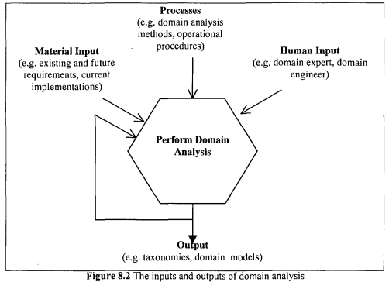

Slide 15
Domain Analysis
Advantages:
The repository of information produced serves, as an invaluable asset to an organisation. The information can be used for training other personnel to the domain in question.
With domain analysis, the impact of stuff turnover can be minimised.
Disadvantages:
It requires a substantial upfront investment.
It is a long-term investment whose benefit will not be realised until the organisation observes some increase in productivity and a reduction in the cost of maintenance as a result of reuse.

Slide 16
Components Engineering
The composition-based approach to reuse involves composing a new system partly from existing components. There are two main ways in which these components can be obtained.
Design for Reuse: This involves developing components with the intention of using them on more than one occasion.
The second way is through Reverse Engineering.

Slide 17
Components Engineering
Design for Reuse:
Characteristics of Reusable Components:
To accommodate the evolutionary nature of a software system during its lifetime, it is essential to anticipate change. This means designing and implementing modules that are susceptible to modification Principles which we believe impact strongly on reusability.
Generality: Generality presents a problem for reusability. It has been observed that solutions that are targeted at a wider problem domain (for example, formal specification) tend to have lower pay-off than those that are targeted at a narrower problem domain.

Slide 18
Components Engineering
Design for Reuse:
Characteristics of Reusable Components:
Cohesion versus coupling: Increasing the degree of reusability of a software component therefore implies high cohesion and loose coupling since the component can be reused without worrying too much about which other modules accompany it.
Interaction: More use of functions rather than source code lines.
Uniformity and Standardisation: Standards help towards uniformity in the techniques used to invoke, control and terminate functions as well as in the methods used for getting help during use of the software

Slide 19
Components Engineering
Design for Reuse:
Characteristics of Reusable Components:
Data and control abstractions: To allow effective reuse, it is essential to have a clear separation between the programs that manipulate data and the data itself.
Interoperability: The increasing popularity of interoperability will aid reuse by allowing systems to take advantage of remote services

Slide 20
Components Engineering
Design for Reuse:
Problems with Reuse Libraries:
The components library plays a central role in composition-based reuse. There are, however, a number of problems associated with designing the library and also obtaining candidate components from it:
The granularity and size dilemma: The classification and search problems can be minimised by having a smaller number of large library fragments, but this increases the problems of understandability and genericity.
The search problem: Without an appropriate mechanism for describing the contents of a components library, it will be difficult for a user to find components that match the requirements of the system to be composed.

Slide 21
Components Engineering
Design for Reuse:
Problems with Reuse Libraries:
The classification problem: It is important to store information in the components library on what components it contains. However, it is not always obvious how to specify this information.
The specification and flexibility problems: It can be difficult to specify how it works and the constraints on its usage. This poses problems for a user intending to undertake white-box reuse.

Slide 22
Components Engineering
Reverse Engineering:
The second way in which reusable components can be made available is by identifying and extracting them from existing systems that were not originally designed for reuse but nonetheless have reusability potentia

Slide 23
Reuse Process Model
In software reuse, the developer or maintainer takes a view that extends beyond single projects or systems.
Reuse involves the exploitation of commonality at many levels of abstraction besides that easily captured in code.
Reuse depends, to a large extent, on the ability to analyse specific domains in order to extract maximally reusable components.
Two models are discussed here:
Generic Reuse/Reusability Model
Accommodating Reuse Model

Slide 24
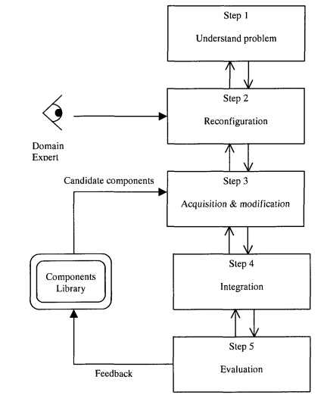
Reuse Process Model
1.Generic Reuse/Reusability Model:
This model has 5 steps:
Step 1: This step involves understanding the problem to be solved and then identifying a solution structure based on predefined components available.
Step 2: The solution structure is then reconfigured in order to maximise the potential of reuse at the current and the next phase
Step 3: The major task at this stage is preparing the reusable components identified in the solution structure in readiness for integration.

Slide 25
Reuse Process Model
1.Generic Reuse/Reusability Model:
Step 4: The main aim at this stage is integrating the completed components into the product(s) required for the next phase of the software life-cycle
Step 5: In this step, the experience from the preceding steps is used to evaluate the reusability prospects of two categories of component.The first category is those components that need to be developed for the sub-problems for which no reusable components exist. The second category is those components that have been obtained from the adaptation of predefined components.

Slide 26
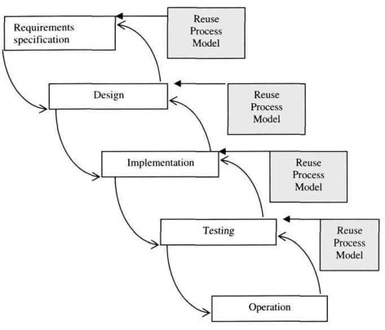
Reuse Process Model
2.Accommodating a Reuse Process Model:
One of the reasons that may discourage organisations from adopting software reuse is the difficulty of accommodating it in an existing software engineering process model.
Without an appropriate mechanism such a change may destabilise the organisational culture which in turn may encourage resistance to the incorporation of reuse into the organisation's process model.

Slide 27
Factors that Impact upon Reuse
Technical Factors:
Programming Languages
Representation of Information
Reuse Library
Reuse-Maintenance Vicious Cycle
Non-Technical Factors:
Initial Capital Outlay
Not Invented Here Factor
Commercial Interest
Education
Project Co-ordination
Legal Issues

